Slide 1
Cluster Analysis: Basic Concepts and Methods
What is clustering?
Types of clustering algorithms
Distance metrics used in clustering
K-Means clustering theory
K-Means numerical example
Evaluation metrics
Real-world applications

Slide 2
What is Cluster Analysis?
Cluster: A collection of data objects
  similar (or related) to one another within the same group
  dissimilar (or unrelated) to the objects in other groups
Cluster analysis Finding similarities between data according to the characteristics found in the data and grouping similar data objects into clusters.
Definition: Clustering is an unsupervised learning technique that groups similar data points based on similarity.
Key idea: Objects in the same cluster are more similar to each other than to those in other clusters.

Slide 3
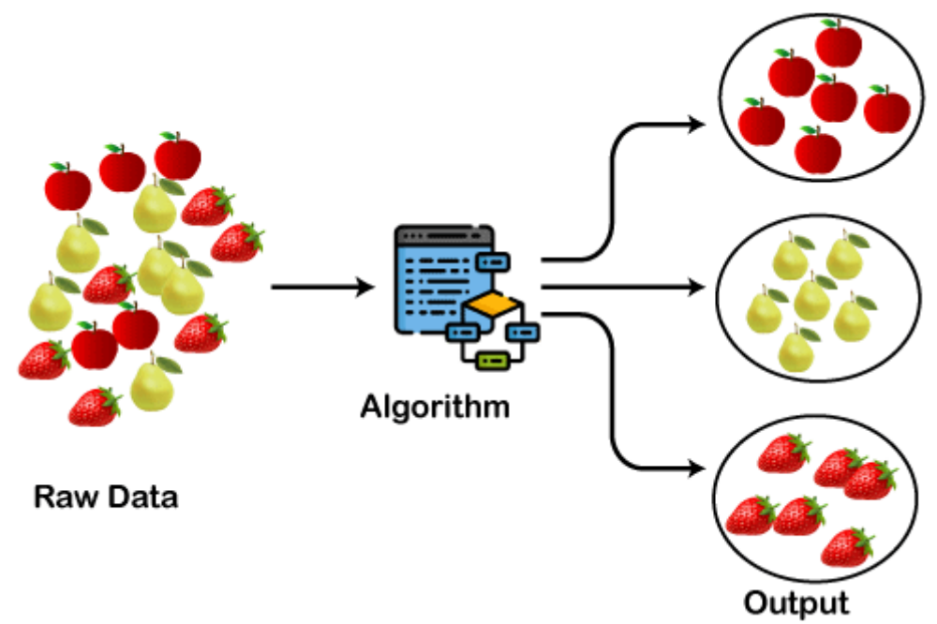
What is Cluster Analysis?

Slide 4
Applications of Cluster Analysis
Data reduction
  Summarization: Preprocessing for regression, PCA, classification, and association analysis
  Compression: Image processing: vector quantization
Hypothesis generation and testing
Prediction based on groups
  Cluster & find characteristics/patterns for each group
Finding K-nearest Neighbors
  Localizing search to one or a small number of clusters
Outlier detection: Outliers are often viewed as those “far away” from any cluster

Slide 5
Clustering: Application Examples
Customer Segmentation: Grouping customers based on behavior or demographics for targeted marketing and personalized services.
Anomaly Detection: Identifying outliers or fraudulent activities in finance, network security and sensor data.
Image Segmentation: Dividing images into meaningful parts for object detection, medical diagnostics or computer vision tasks.
Recommendation Systems: Clustering user preferences to recommend movies, products or content tailored to different groups.
Market Basket Analysis: Discovering products frequently bought together to optimize store layouts and promotions.

Slide 6
Quality: What Is Good Clustering?
A good clustering method will produce high quality clusters
  high intra-class similarity: cohesive within clusters
  low inter-class similarity: distinctive between clusters
The quality of a clustering method depends on
  the similarity measure used by the method
  its implementation, and
  Its ability to discover some or all of the hidden patterns

Slide 7
Major Clustering Approaches
Partitioning approach:
  Construct various partitions and then evaluate them by some criterion, e.g., minimizing the sum of square errors
  Typical methods: k-means, k-medoids, CLARANS
Hierarchical approach:
  Create a hierarchical decomposition of the set of data (or objects) using some criterion
  Typical methods: CURE, CAMELEON
Density-based approach:
  Based on connectivity and density functions
  Typical methods: DBSACN, OPTICS
Grid-based approach:
  based on a multiple-level granularity structure
  Typical methods: STING, CLIQUE

Slide 8
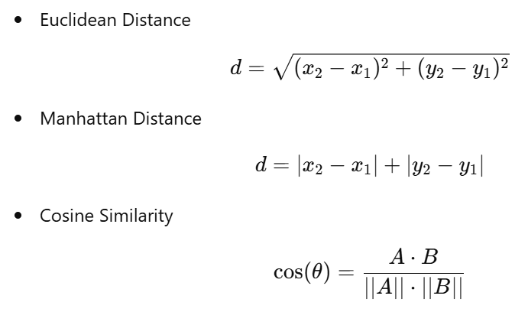
Distance Metrics

Slide 9
Partitioning Algorithms: Basic Concept
Partitioning clustering organizes data points around central prototypes called centroids, where each cluster is represented by the mean (or medoid) of its members.
The number of clusters is specified in advance and the algorithm allocates points to the nearest centroid, making this technique efficient for spherical and similarly sized clusters but sensitive to outliers and initialization.
Algorithms:
K-means: Iteratively assigns points to nearest centroid and recalculates centroids to minimize intra-cluster variance.
K-medoids: Similar to K-means but uses actual data points (medoids) as centers, robust to outliers.

Slide 10
Partitioning Algorithms: Basic Concept
Pros:
  Fast and scalable for large datasets.
  Simple to implement and interpret.
Cons:
  Requires pre-knowledge of kk.
  Sensitive to initialization and outliers.
  Not suitable for non-spherical clusters.

Slide 11
The K-Means Clustering Method
Given k, the k-means algorithm is implemented in four steps:
  Partition objects into k nonempty subsets
  Compute seed points as the centroids of the clusters of the current partitioning (the centroid is the center, i.e., mean point, of the cluster)
  Assign each object to the cluster with the nearest seed point
  Go back to Step 2, stop when the assignment does not change

Slide 12
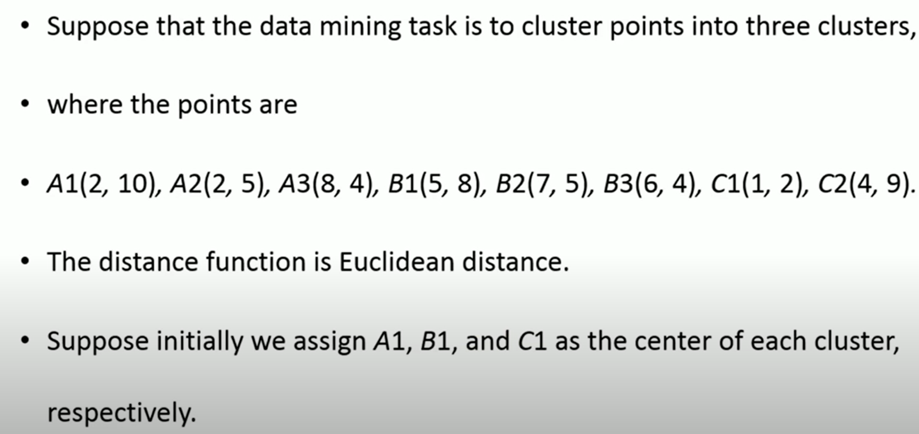
K-Means Numerical

Slide 13
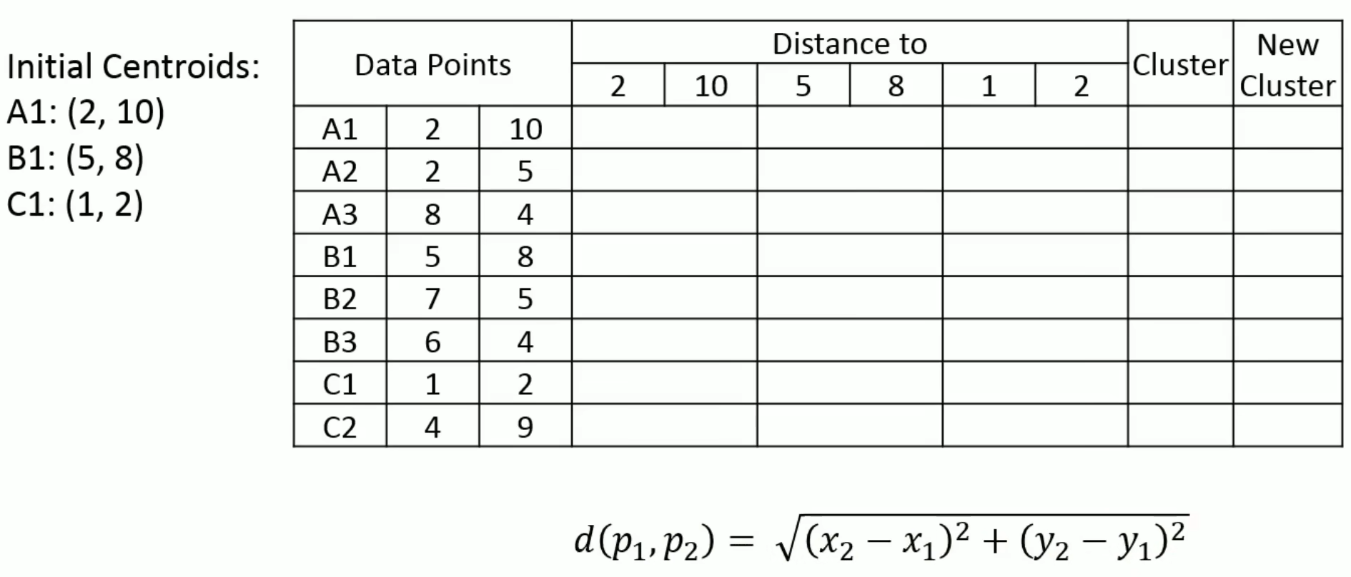
K-Means Numerical

Slide 14
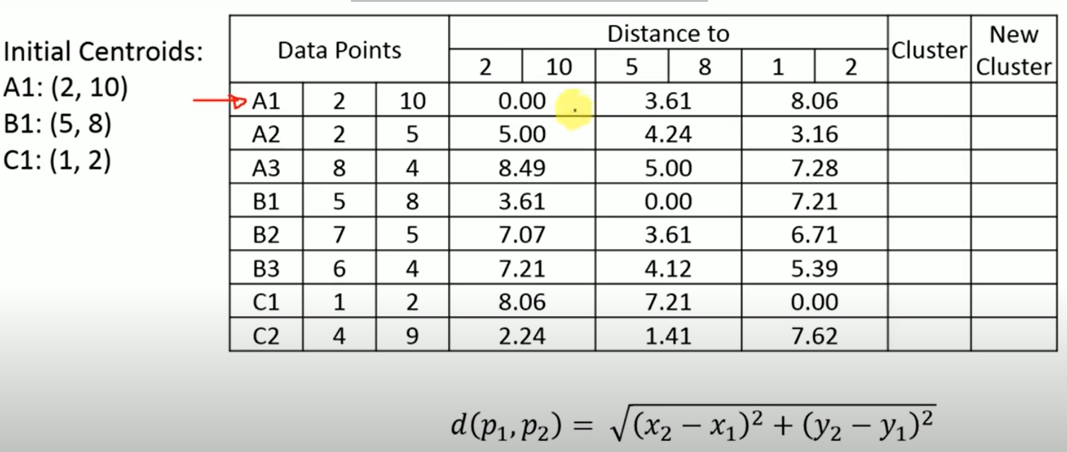
K-Means Numerical

Slide 15
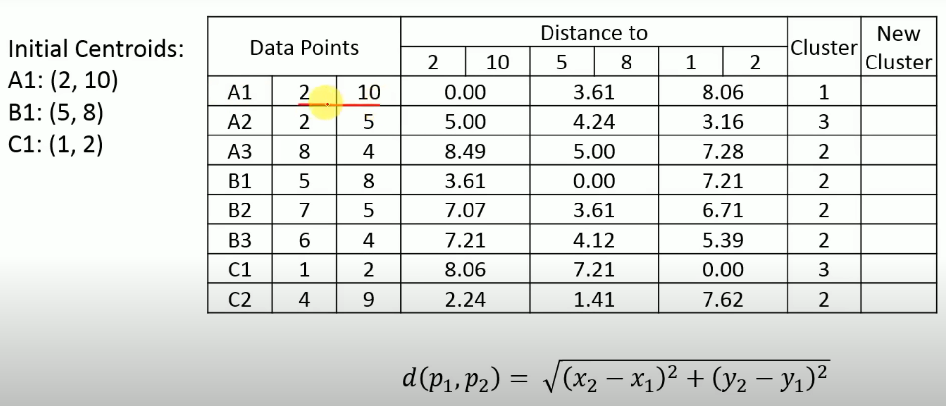
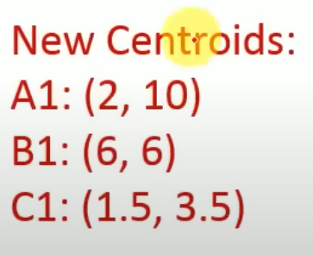
K-Means Numerical

Slide 16
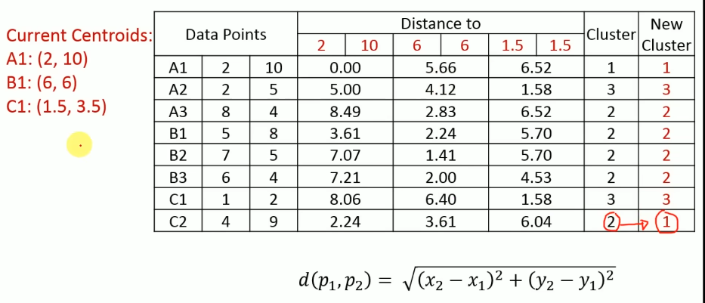
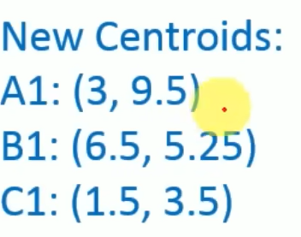
K-Means Numerical

Slide 17
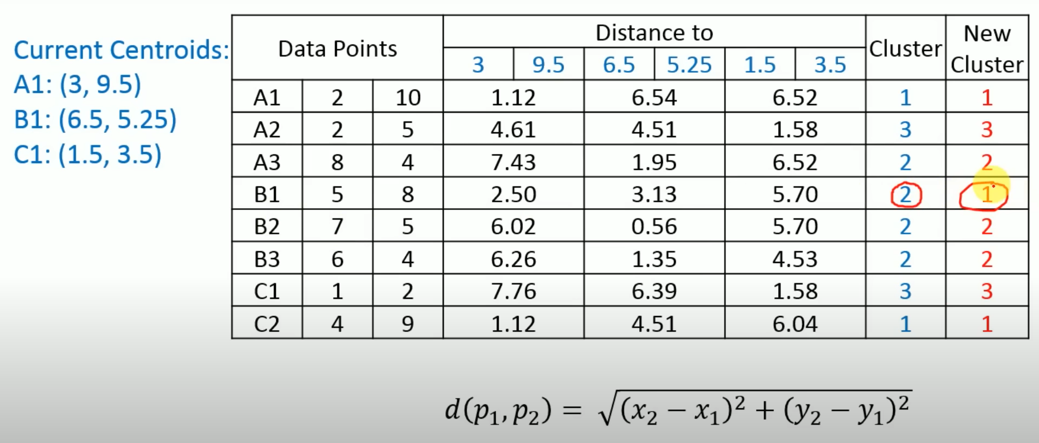
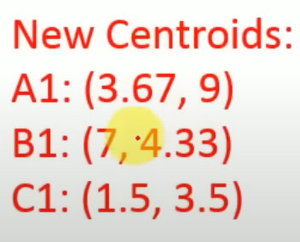
K-Means Numerical

Slide 18
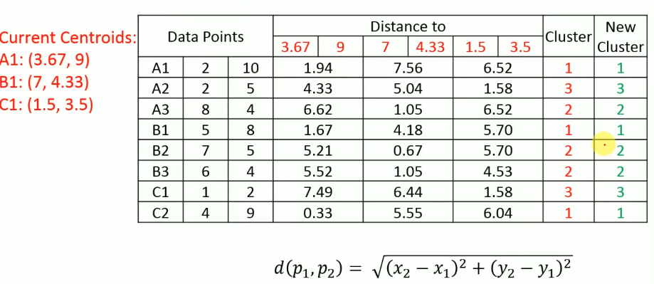
K-Means Numerical

Slide 19
Numerical Examples
https://medium.com/@karna.sujan52/k-means-algorithm-solved-numerical-3c94d25076e8
https://www.youtube.com/watch?v=j6MLvnaMQEI
https://www.youtube.com/watch?v=FllcPjvztTI

